Slide 1

First Arduino Project

Slide 2

Project With Arduino
Software
Hardware
Project

Slide 3
Project With Arduino
Software
Hardware
Project
c++
Arduino IDE
…..

Slide 4
Project With Arduino
Software
Hardware
Project
c++
Arduino IDE
…..
Arduino
Sensor
Motor
Servo
…..

Slide 5
Project With Arduino
Software
Hardware
Project
c++
Arduino IDE
…..
Arduino
Sensor
Motor
Servo
…..
Project Building

Slide 6

Software
Type var_name = data :
Types variable :
int
char
float
int number = 12120 ;
float num_Float = 12 . 5 ;
char _char = ‘A’ ;

Slide 7

Software
Type myfunction ( )
{
// my code ….
}
int main ( ) {
int number = 12 ;
cout<< “number is ”<<number;
}

Slide 8

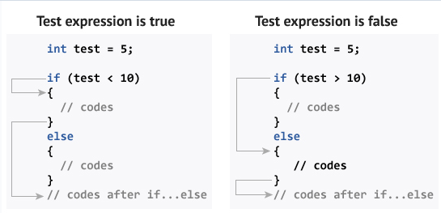
Software
if ( true)
{
// my code ….
}
if ( number == 12) {
cout<< “true” ;
}
else
{
cout<<“false” ;
}
if ( var == 12) {
cout<< 1 ;
}
if else (var == 10)
{
cout<< 2 ;
}
else {
cout<< 3 ; }
if ( false)
{
// my code ….
}

Slide 9

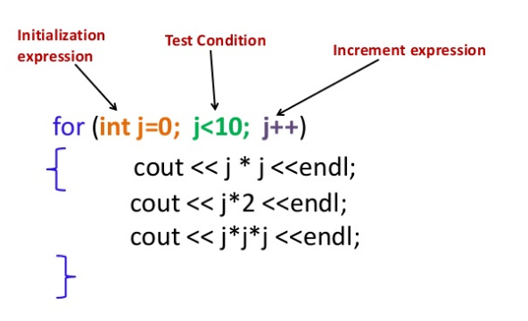
Software

Slide 10

What is Arduino?
Arduino is an open-source electronics platform based on easy-to-use hardware and software.
Arduino boards are able to read inputs - light on a sensor, a finger on a button, or a Twitter message - and turn it into an output - activating a motor, turning on an LED, publishing something online.

Slide 11
Why Arduino?
Inexpensive
Cross-platform
Simple, clear programming environment
Open source and extensible software
Open source and extensible hardware

Slide 12
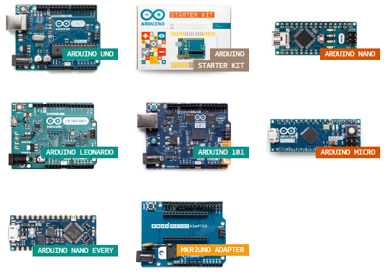
Arduino boards

Slide 13
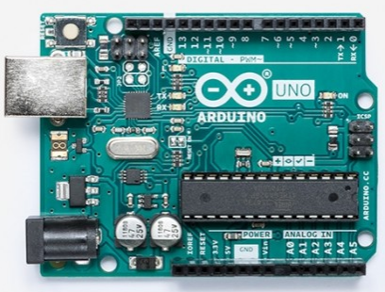
Arduino boards
Name | Processor | Operating/Input Voltage | CPU Speed | Analog In/Out | Digital IO/PWM | EEPROM [kB] | SRAM [kB] | Flash [kB] | USB
Uno | ATmega328P | 5 V / 7-12 V | 16 MHz | 6/0 | 14/6 | 1 | 2 | 32 | Regular

Slide 14
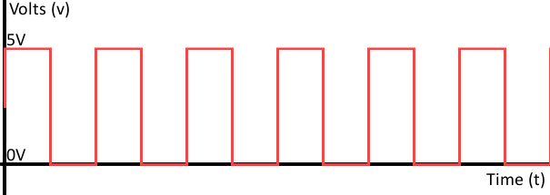
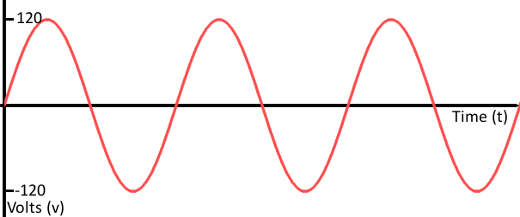
Arduino boards
Name | Processor | Operating/Input Voltage | CPU Speed | Analog In/Out | Digital IO/PWM | EEPROM [kB] | SRAM [kB] | Flash [kB] | USB
Uno | ATmega328P | 5 V / 7-12 V | 16 MHz | 6/0 | 14/6 | 1 | 2 | 32 | Regular

Slide 15
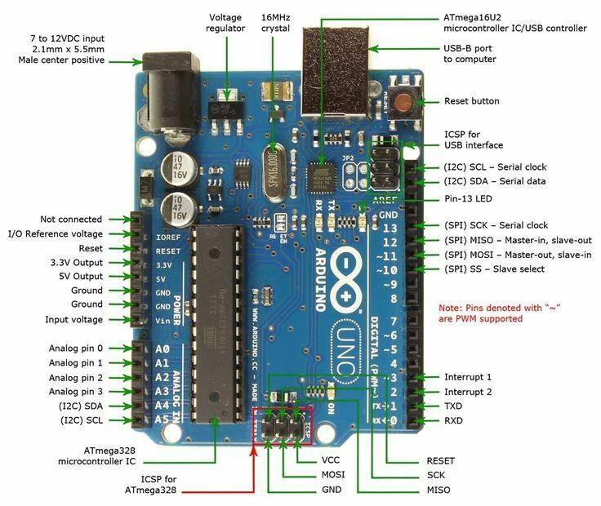
Arduino boards

Slide 16
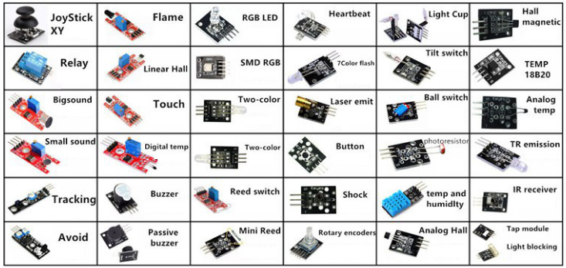
Arduino Sensor

Slide 17
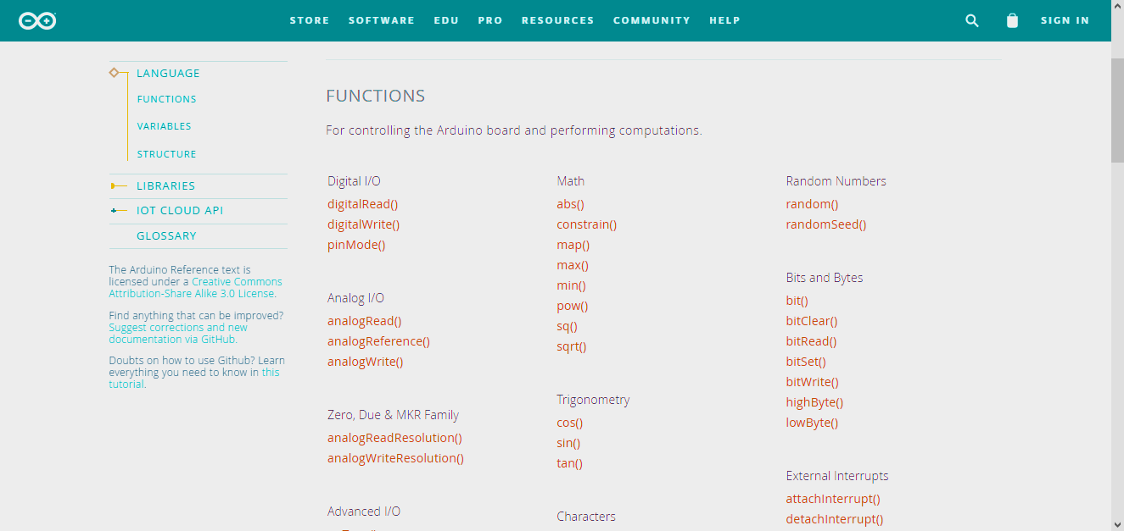
FUNCTIONS

Slide 18
FUNCTIONS
pinMode
pinMode(12, OUTPUT);
digitalWrite
digitalWrite(12, HIGH);
delay
delay(1000);
Open arduino

Slide 19
FUNCTIONS
int ledPin = 10;
int sensorPin = 12;
void setup()
{
pinMode(ledPin, OUTPUT); // sets the digital pin as output
pinMode(sensorPin, INPUT); // sets the digital pin as input
}

Slide 20
FUNCTIONS
void loop()
{
// digitalWrite( pin , mode );
digitalWrite( 4 , HIGH );
}

Slide 21
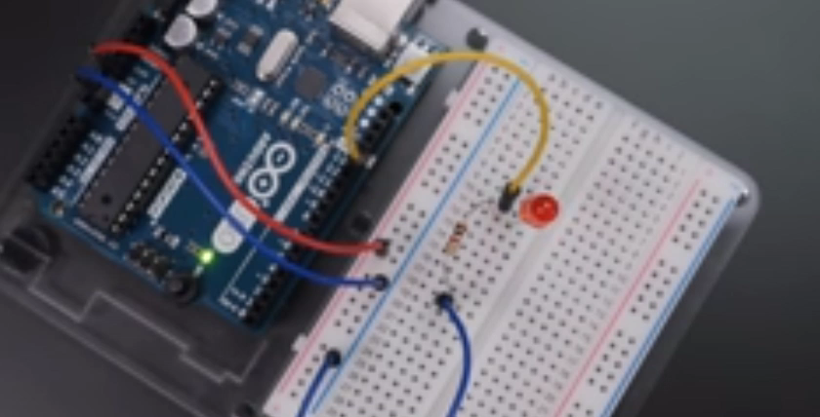
Project
delay(1000)

Slide 22
Project
void setup()
{
pinMode(9, OUTPUT);
}
void loop()
{
digitalWrite(9, HIGH); // ON
delay(1000);
digitalWrite(9, LOW); // OFF
delay(1000);
}
You will need :
LED
Arduino uno
Wires
Breadboard

Slide 23
Project
delay(1000)

Slide 24
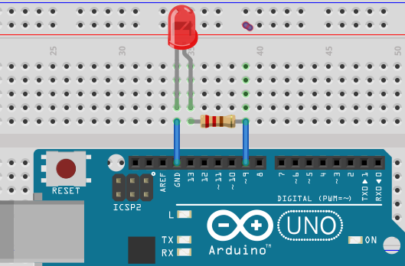
Project

Slide 25
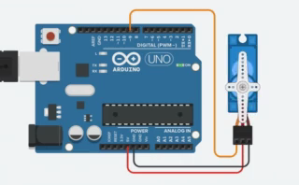
Project

Slide 26
Project
#include <Servo.h>
Servo myservo;
int pos = 90;
void setup() {
myservo.attach(9);
}
void loop() {
myservo.write(pos);
}
delay(1000)
You will need :
Arduino Uno
Wires
Servo Motor

Slide 27
Project
#include <Servo.h>
Servo myservo;
int pos = 0;
void setup() {
myservo.attach(9);
}
void loop() {
for (pos = 0; pos <= 180; pos += 1) {
myservo.write(pos);
delay(15);
}
for (pos = 180; pos >= 0; pos -= 1) {
myservo.write(pos);
delay(15);
}
}
You will need :
Arduino Uno
Wires
Servo Motor
delay(1000)

Slide 28
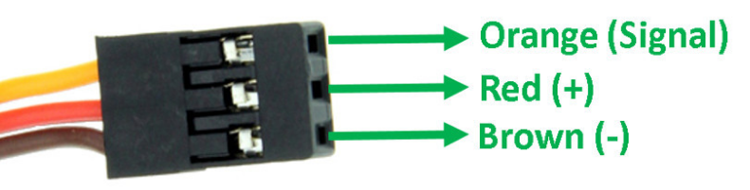
Project

Slide 29
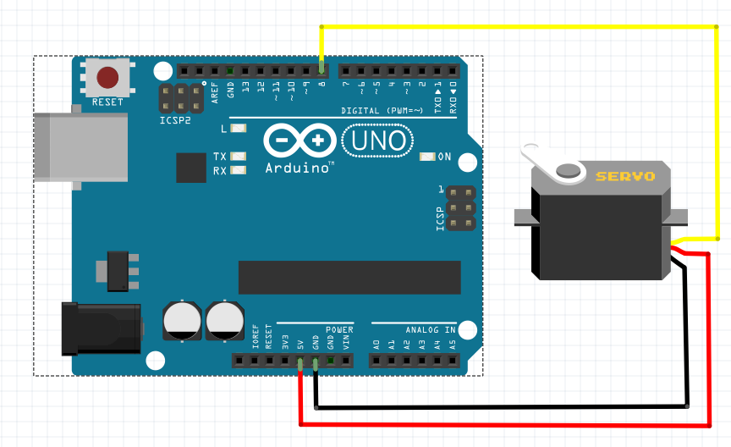
Project

Slide 30
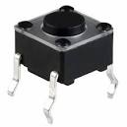
Project

Slide 31
Project
int led = 11 ;
int button = 5;
void setup ( ) {
pinMode(led , OUTPUT);
pinMode(button , INPUT);
}
Void loop ( ) {
if (digitalRead(button)==HIGH) {
digitalWrite(led , HIGH);
}
else { digitalWrite(led , LOW); }
}
You will need :
Arduino Uno
Breadboard
Wires
LED
PushButton

Slide 32

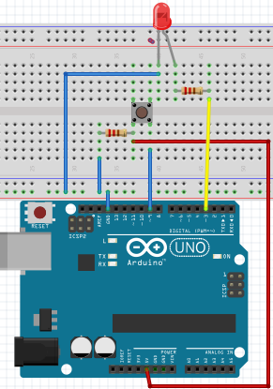
Project

